Slide 1
Strategy and Corporate Affairs update
Clare Ettinghausen
Director of Strategy and Corporate Affairs
4 December 2018

Slide 2
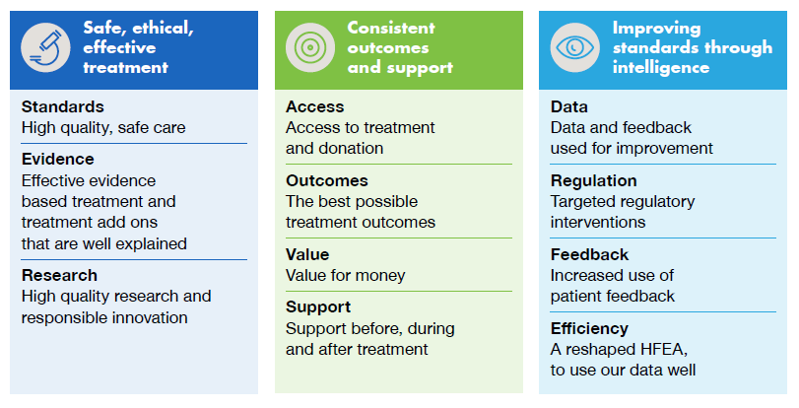
Our strategy for 2017-20

Slide 3
Achievements against strategy 1
Safe, ethical, effective treatment
Objectives | Ensure that all clinics provide consistently high quality and safe treatment Publish clear information so that patients understand treatments and treatment add ons and feel prepared Engender high quality research and responsible innovation in clinics
What we’ve done in the first 18 months: | Published detailed information about treatment add ons, with traffic light ratings for patients. Updates to these are now a routine task for SCAAC. Published more information about clinic performance in the state of the sector report. Increased the emphasis on consistent standards in our inspection programme, continued to focus on learning from incidents and events and embedded this into our ways of working. Started the leadership project to define what good clinic leadership looks like. Started developing a dashboard to provide clinics with benchmarking data through PRISM.
To do: | Continuing our leadership project, engaging with clinic staff, and particularly PRs, to share good performance and model excellent leadership in clinics, running an event for PRs later in 2018 and in 2019. Further embedding patient feedback into the inspection and licensing regimes to enable more targeted regulatory interventions. Establishing quality criteria to recognise excellent patient care in clinics and allow patients to easily assess the quality of the care provided. Presenting further benchmarking data to clinics, to allow them to review their own performance.

Slide 4
Achievements against strategy 2
Consistent outcomes and support
Objectives: | Improve access to treatment Increase consistency in treatment standards, outcomes, value for money and support for donors and patients.
What we’ve done in the first 18 months: | Provided information for those considering going abroad for treatment on how they might access services in the UK, with a regular talk at fertility shows. Began work on the national patient survey. Worked with NHS England and other stakeholders on drafting commissioning guidance. Provided more information about access to donor treatment. Produced guidance on support for patients, donors and donor-conceived people for the Code of Practice. Reviewed how clinics publish success rates on their own websites. Collaborated with NHS Choices to establish links with our new website and put new patients in touch with better information about services.
To do: | Engaging with the sector to ensure compliance with requirements in the new Code of Practice on patient support. Reviewing the effectiveness of our work to encourage embryo research, seeking new ways to encourage and support research, working with research centres and PRs. Involving our stakeholders in defining and establishing the factors that lead to successful outcomes. Engaging with the sector about the benchmark price for treatment. Managing counselling support services for Register applicants.

Slide 5
Achievements against strategy 3
Improving standards through intelligence
Objective: | Use our data and feedback from patients to provide a sharper focus in our regulatory work and improve the information we produce
What we’ve done in the first 18 months: | Established the Intelligence team to ensure we have the analytical capability and capacity to extract more value from the data we hold. Published our information strategy on how we will analyse, publish and use data. Published more and better reports using our data, such as the Fertility Trends report. Began to collect high quality patient feedback, on our website, through focus groups and the pilot national patient survey and started to analyse and use this intelligence.
To do: | Publishing and acting on the findings of the pilot national patient survey. Continuing to analyse Register data on success rates and explore with professionals the key factors behind success at the clinic level. Promote commissioning guidance Reviewing our patient engagement channels and piloting a new patient forum to ensure we have access to feedback to inform our activities.

Slide 6
The ‘Stratcad’ directorate
Planning and Governance
Head: Paula Robinson
Licensing
Corporate governance
Strategic and Business planning
Risk management
Programme management
Performance Monitoring
Research and Intelligence
Head: Caylin Joski-Jethi
Information access
Data analysis
Intelligence reports
Data research governance
FOIs and PQs
Engagement and Communications
Head: Jo Triggs
Patient information/enquiries
Internal communications
Media, campaigns, reports
Communications with clinics
Stakeholder engagement
Regulatory Policy
Head: Laura Riley
Standards and guidance
Public enquiries
Stakeholder engagement
Scientific horizon scanning
Policy project across and outside organisation

Slide 7
Directorate risks: trends
2016 risks
CaFC litigation
Vacancies in Governance
PQ/FoI resilience
Capacity issues in Comms
Stakeholder acceptance of website
2017 risks
Appeal and CaFC litigation
Staff turnover
Capacity in Governance
Comms impact
Capitalising on data opportunities
2018 risks
Appeal and CaFC litigation
Staff turnover/Capacity of key staff
Comms impact
Capitalising on data opportunities
Code implementation - realising changes in Clinic practice

Slide 8
Directorate challenges
Staffing
Communicating what we do
Using our resources
Balancing quality with risk

Slide 9
Any questions?
Clare Ettinghausen
clare.ettinghausen@hfea.gov.uk

